Slide 1
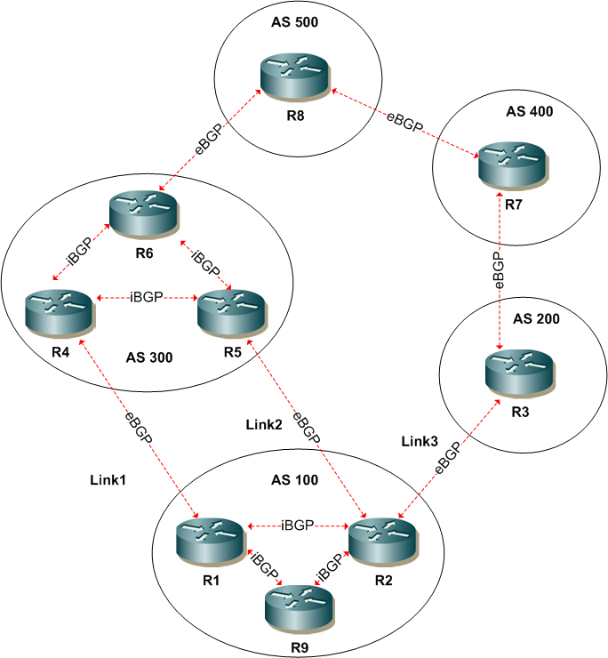
EXERCISE

Slide 2
Instructions
Consider BGP policy solutions for each of the following scenarios
Once complete, define IOS configurations for each scenario policy

Slide 3
Scenario 1
For a prefix originated in AS500 which link would R2 prefer outbound ?
Why would it not prefer the link to R1

Slide 4
Scenario 2
Apply a policy in AS100 so that link 1 is favoured outbound via R1.

Slide 5
Scenario 3
Apply a policy in AS100 so that AS500 uses the path via AS400 to AS100

Slide 6
Scenario 4
Apply a policy in AS100 so that AS300 uses link2 to reach AS100 but does not influence AS500.

Slide 7
Scenario 5
Apply a policy in AS100 so that AS300 does not advertise any AS100 originated routes external to AS300

Slide 8
Scenario 6
What AS_PATH regex could R3 use to match prefixes originating in AS500?
What AS_PATH regex could R2 use to match prefixes from directly connected AS200?
What AS_PATH regex could R8 use to match prefixes learned via AS100 or AS200?

Slide 9
Scenario 7
Define a policy for AS100 so that AS300 will use the R5 to R2 link for specific prefixes advertised by AS100 to AS300. Do not use AS-PATH prepending or MED.

